Slide 1
Shopping Lists on the Cloud
Large Scale Distributed Systems
Diogo Costa (202007770)
Manuel Amorim (202007485)
Miguel Teixeira (202005208)

Slide 2
Problem description
This project aims to develop a shopping list application that primarily prioritizes local functionality. The application needs to be designed to operate on the user's device, enabling local storage. Additionally, it must incorporate a cloud-based component that facilitates data sharing among users.

Slide 3

Requirements
Local First
Concurrency
Synchronization
The user needs to be able to create and edit lists completely offline
The application must handle concurrent changes to shopping lists
The application must implement conflict handling upon list manipulation

Slide 4

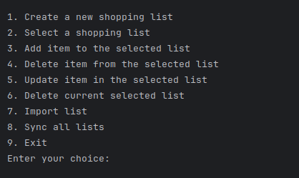
User Interface

Slide 5
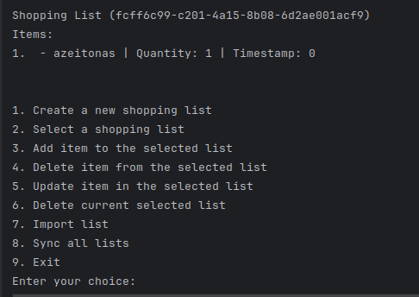
Editing and Managing Lists
The user can create, import or delete shopping lists
The user can edit, add items or delete them
In case of no connection to server, everything is handled locally and later synced

Slide 6
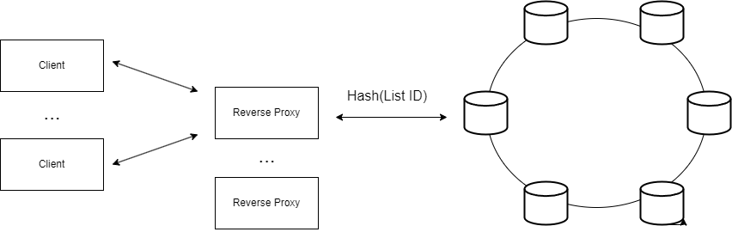
Client Synchronization

Slide 7
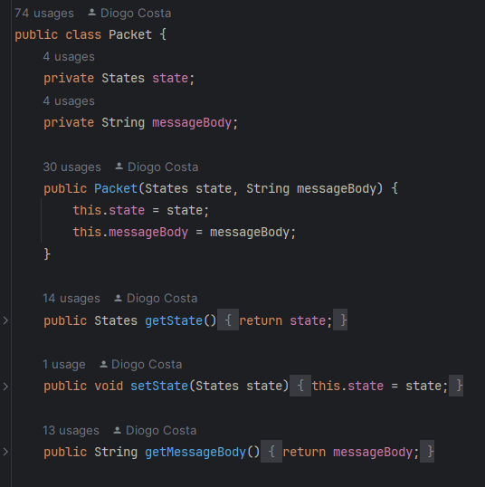
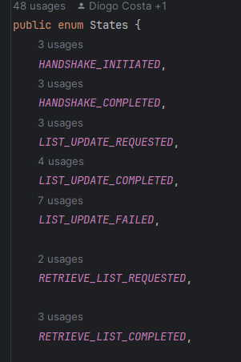
Client server communication
All requests use the Packet class, which is then serialized to JSON
The state allows the receiving party to know what the body contains, therefore allowing the deserialization of the information (into shopping lists, hash ring information, etc…)

Slide 8
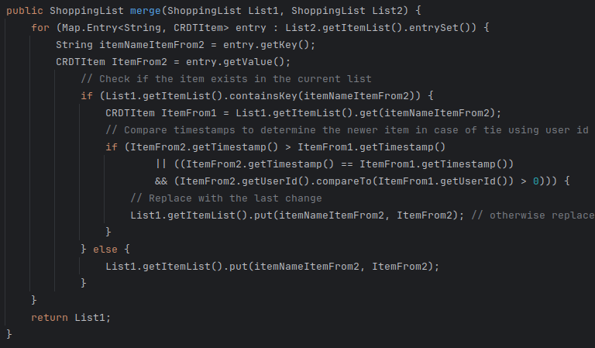
CRDT Implementation
Shopping list ⇾ Map of CRDTS Items
CRDT Item ⇾ (Name, Quant,TimeStamp,UserID)
Local Timestamp handling
Deleted Items Approach

Slide 9
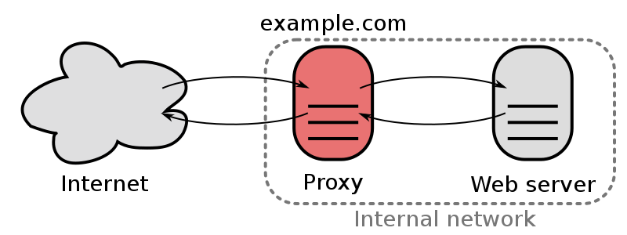
Reverse Proxy
A reverse proxy sits in front of one or more servers and forwards client (e.g., browser) requests. It acts as an intermediary for requests from clients seeking resources from the servers.
Reverse proxies provide additional layers of security, anonymity, and can be used for load balancing. They are also useful for future integration of microservices such as authentication, web servers, etc.

Slide 10
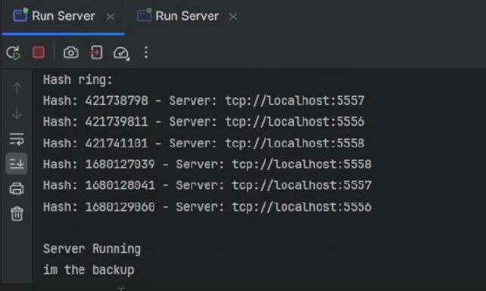
Reverse Proxy backup
Since every aspect of the system architecture must have redundancy, our reverse proxy can also have backups
If the router is unable to ping the server, it will default to a list of backup servers
The introduction of simple ping requests is important so that we could shorten the timeout between requests, otherwise the user experience would deteriorate

Slide 11
Consistent hashing
Distributed Architecture: It allows for the distribution of data across a set of nodes (such as servers or data centers), which can help in handling high loads and providing redundancy.
Minimizing Reorganization: When a node is added or removed, only a small portion of the keys need to be remapped, which is much more efficient compared to traditional hash table implementations where a significant amount of keys might need remapping.
Load Balancing: While not perfect, consistent hashing tends to spread load fairly evenly among the nodes in a cluster.
Scalability: It's particularly well-suited for environments where the set of nodes needs to change dynamically over time, making it a popular choice in distributed systems like caches (e.g., in content delivery networks) and databases.

Slide 12
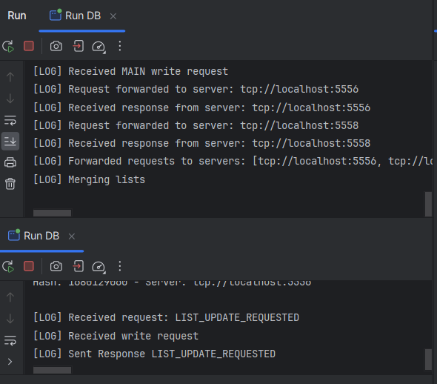
Read and Write operations
When a shard receives the main request, it forwards it to the next shards in the hash ring
They merge the request with the local version of their lists and return the merged list
This list gets once again merged in the original request’s shard, allowing the CRDTs to guarantee that the most updated version prevails

Slide 13
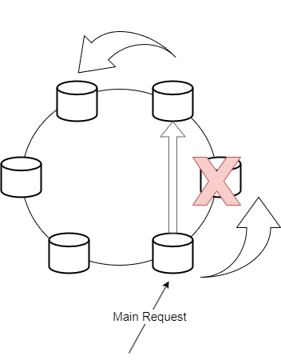
Hash ring failover handling
Redirection of Requests: Subsequent requests that would have been handled by the failed node are now redirected to the node(s) that have taken over the failed node's data range.
Data Replication: the data from the failed node will already be present on another node. The number of replicas is configurable in our project through a global constant.

Slide 14
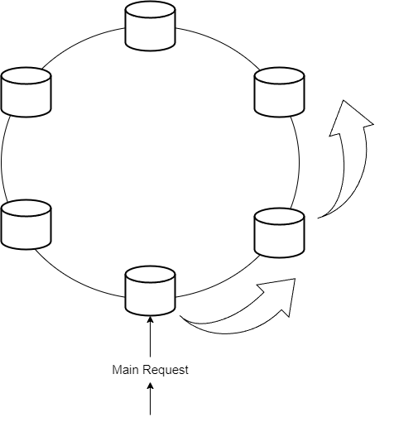
Server request forwarding
Hash is determined by the list id
hash belongs to a range of values handled by a given virtual node
The physical server that originated the virtual node receives the main request
An arbitrary number of information replicas are created (physical server replicas)

Slide 15
Our Limitations
Reinsertion of a deleted item user feedback
No multithreading
Makes CRUD operations on the client feel sluggish
Makes server requests not have the minimum possible latency
Better hashing function distribution

Slide 16
Thanks!
%

